Slide 1
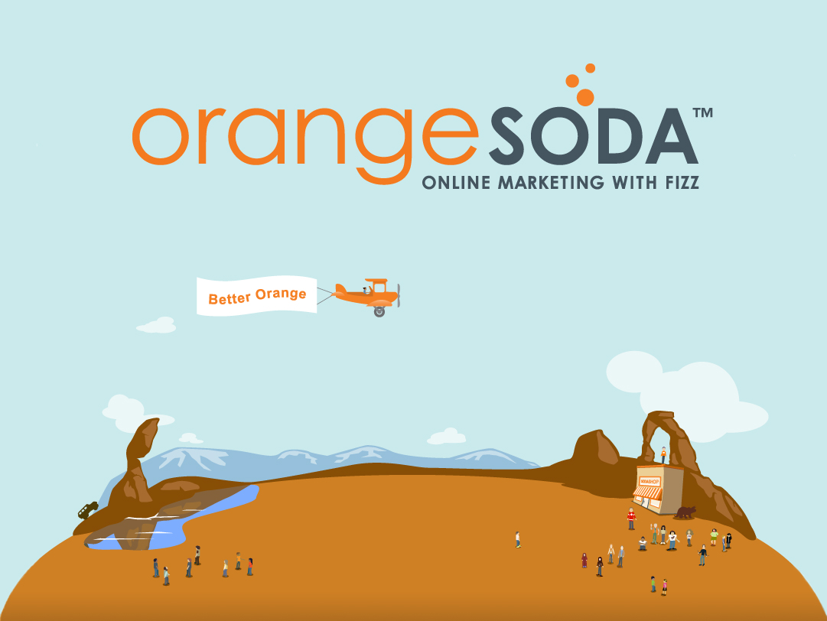

Slide 2

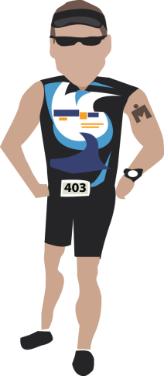
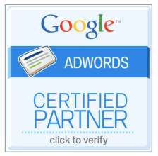


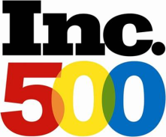
OrangeSoda
Founders: Jay Bean and Derek Miner
Founded: 2006
Employees: 170+
Location: American Fork, UT
Products: Blend, SEO, PPC, Maps, & Social Media

Slide 3
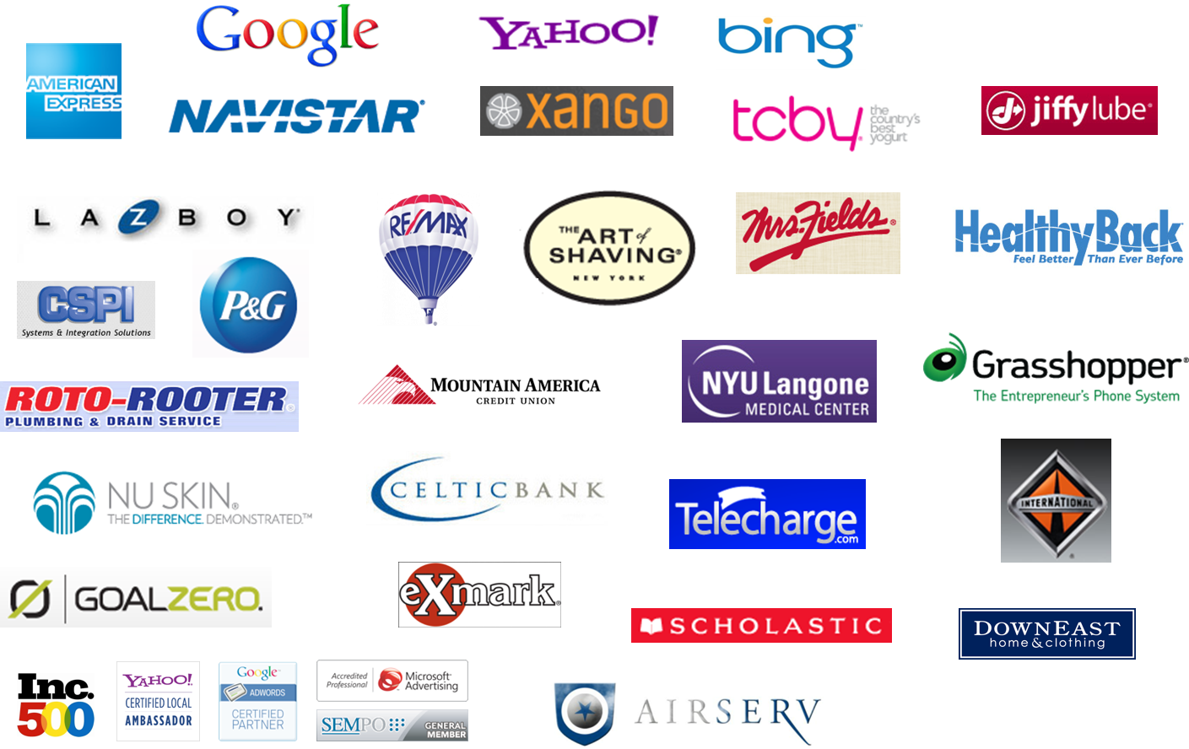
Some of Our Clients

Slide 4

What Our Customers Can Expect
Our Clients Have Realized
2x-5x increase in conversions
200%+ return on ad spend (ROAS)
170% increase in exposure

Slide 5
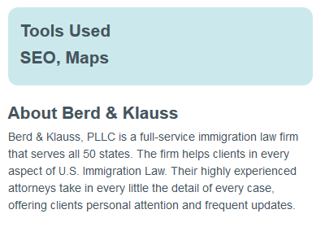
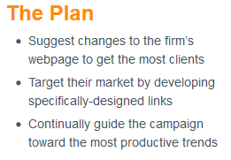
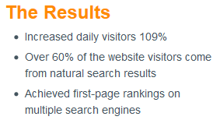
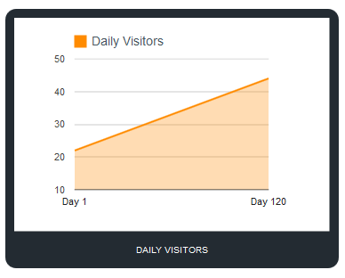
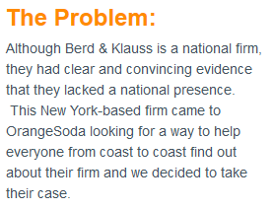
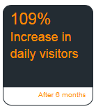
Case Study: Berd & Klauss

Slide 6

What Makes OrangeSoda Different
Results
  85% percent of clients reach first page within 6 months
Awards
  Ranked one of the top 5 SEO companies by Website Magazine*
Proprietary Technology System
  Simple reporting for clients
  Detailed monitoring for strategic campaign decisions
  Recognized by Google for our technology platform (2009 & 2010)
Insight into the Local Search
  Data Pool of Several Thousands of Clients
    Trends and Inside Insight
Proprietary Networks and Processes
  *http://www.seo.com/blog/utah-hub-seo-companies/

Slide 7
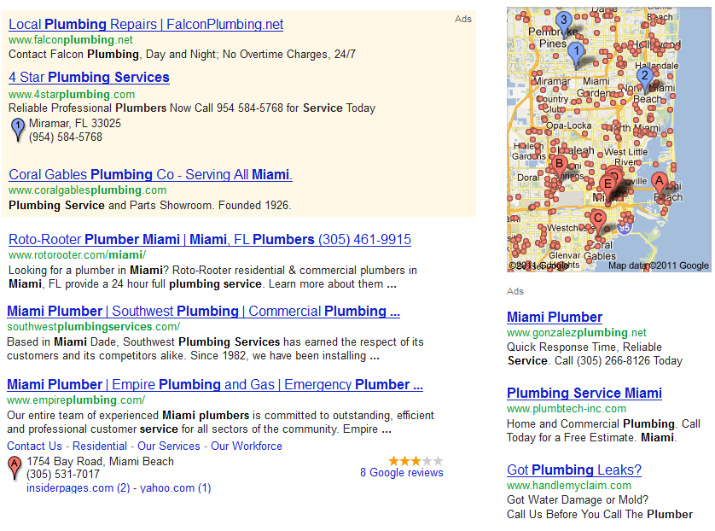

Need for Local Online Marketing
89% of users will not leave the first page to find a local business.

Slide 8
Search Engine Marketing Share

Slide 9

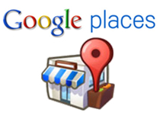
Market Reach
Market Reach: Estimated number of the potential customers it is possible to reach through an advertising medium or a promotional campaign.
100%
PPC
Maps
Total Reach
SEO
0%

Slide 10
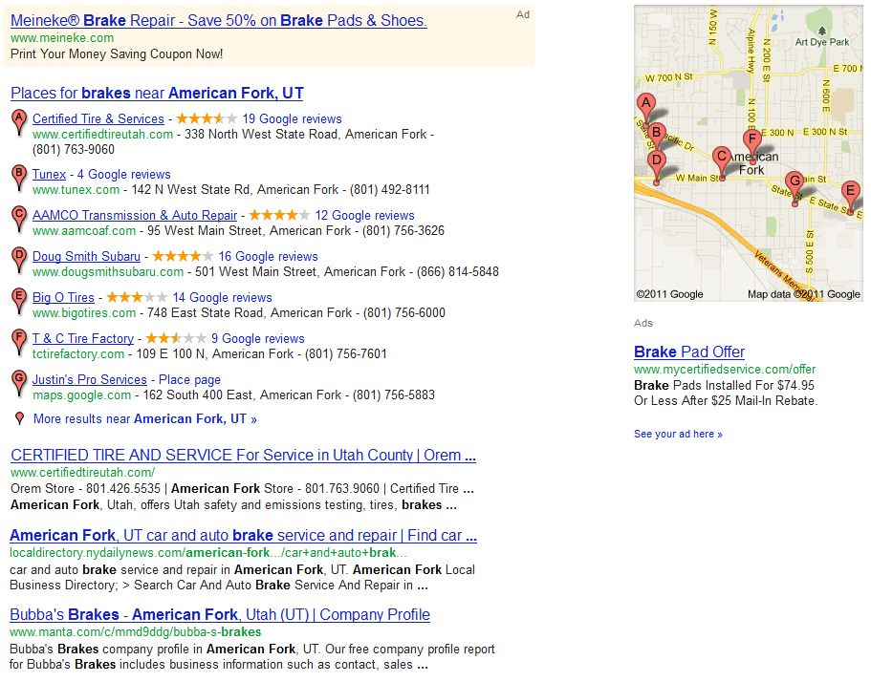
Historic Search Marketing
PPC
Difficult to Manage
More Expensive
Less Market Reach
Lower Returns
Maps
SEO
Sections of the SERP are obviously divided. To maximize ones reach, they targeted each section of the SERP individually using an a la carte marketing method. This is when customers pick and choose what products they want.

Slide 11
Blended Search Marketing Packages
Easier to Manage
Less Expensive
Maximum Market Reach
Higher Returns
Blended Search Marketing Campaign
Sections of the SERP are merging. Maps are now blended within the organic results. Map listings can also appear within the sponsored links. To maximize ones reach, one must tailor marketing strategies for the merged SERP.

Slide 12

SEO
Search Engine Optimization

Slide 13
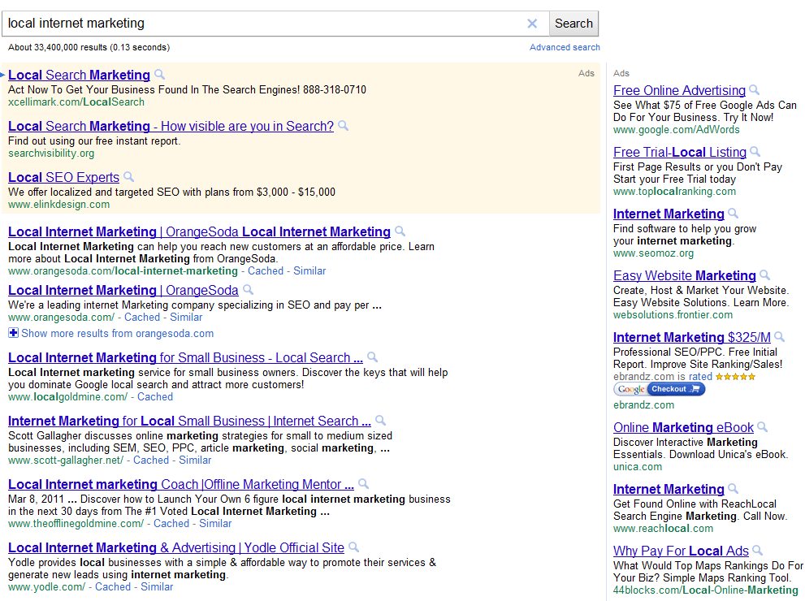

Search Engine Optimization
Search Engine Optimization (SEO): Enhancing a website so it ranks higher on search engines like Google
How it Works:
Google uses over 200 grading factors to determine a website’s rank
Sites must be
Relevant to searches
Popular on the web

Slide 14




How SEO Works
SEO
Relevancy Factors: Onsite
Content Optimization
H1s (headings)
Keyword density
Appropriate keyword usage
Code Optimization:
Popularity Factors: Offsite
Link-Building:
Number of links to your site
Types of links to your site
Method of linking to your site
Link value
Link diversity
Making links look natural
Title tags
Meta tags
Sitemaps
Robots txt.
Alt Images
Because SEO is “organic” it takes time for clients to see results and return on investment. By the 6th month, 85% of OrangeSoda clients are on the first page.

Slide 15
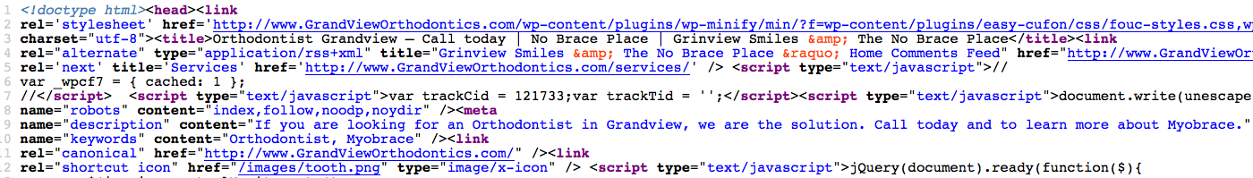
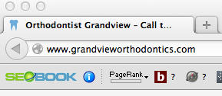
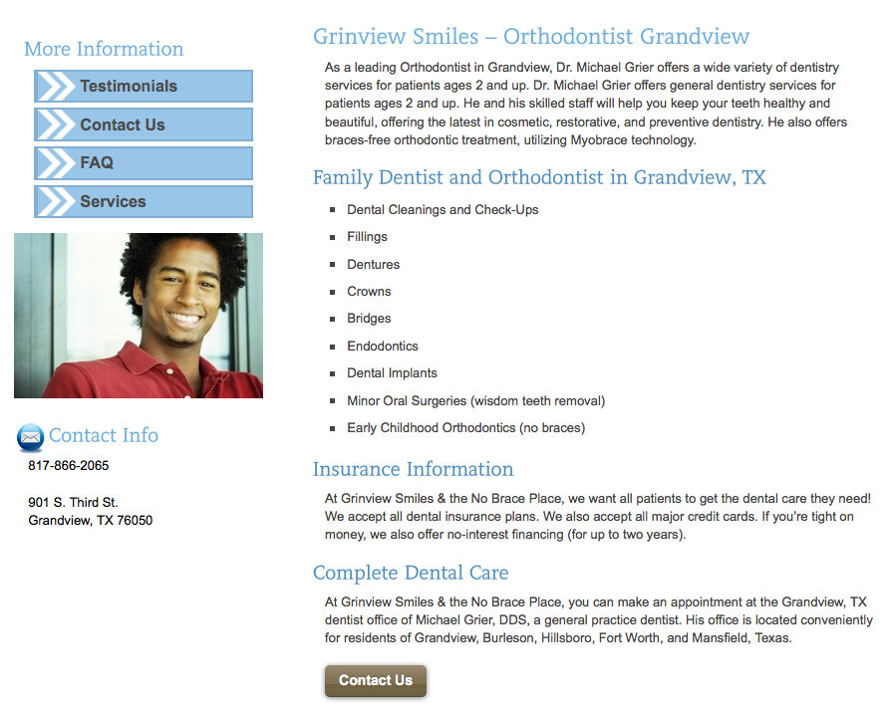

Relevance – Coding & Content
Keyword-rich headers
Use of main and secondary
keywords in text
Title and meta tags tell search engines what you want to rank for.
Other factors include:
Sitemap files
Robots txt files
Canonical URLs
Alt text
Professionally-written content

Slide 16
Popularity – Link Building
Campaigns are assigned a roadmap with a diverse link-building strategy.*
Social Media Page
Social Bookmark
Niche Directory
General Directory
Online Article
Blog Post
Blog Post
Online Article
General Directory
Niche Directory
Social Bookmark
Press Release
Social Media Page
Client’s Site
Of the 10 most important SEO ranking factors, seven deal with links.
*An example roadmap can be seen in the appendix

Slide 17

SEO Summary
What it is:
The process of improving a website’s organic ranking on search engines
How you do it:
Increase site relevance and popularity
Why it’s important:
In 2011, Google had 3 billion searches a day
17% of searches are done with the intent to find a company that provides a specific product or service
89% of searchers only look at the first page
80% of clicks go to the organic listings
SEO allows you to be found when people search for your products
and services.
Notes:
3 billion searches a day were done on Google in 2011 - SEOMOZ
17% of searches are done with the intent to find a company that provides a specific product or service - Search Engine Land, 2011 - http://searchengineland.com/local-search-a-multi-site-cross-platform-affair-report-86530

Slide 18
Map Optimization
Map Optimization

Slide 19
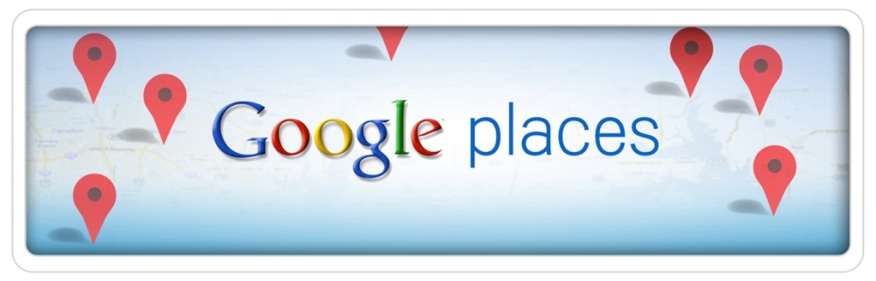

Places and Google+ Local
At the end of May 2012, Google Places merged with Google+ to create Google+ Local pages. This merger does not change the optimization process, but it does make it easier for searchers to find and review information about local businesses.

Slide 20
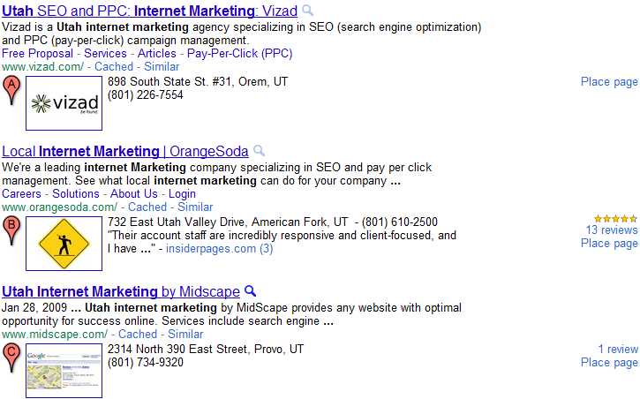
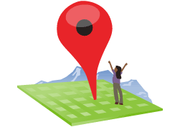
Maps Optimization
Maps Optimization: Maps Optimization is the act of enhancing a Google+ Local Page so it receives more exposure when someone conducts a local search.
How it Works: Google grades local businesses according to three major factors: location, relevance, and popularity.
Optimizing Location
Increasing Relevance
Increasing Popularity

Slide 21
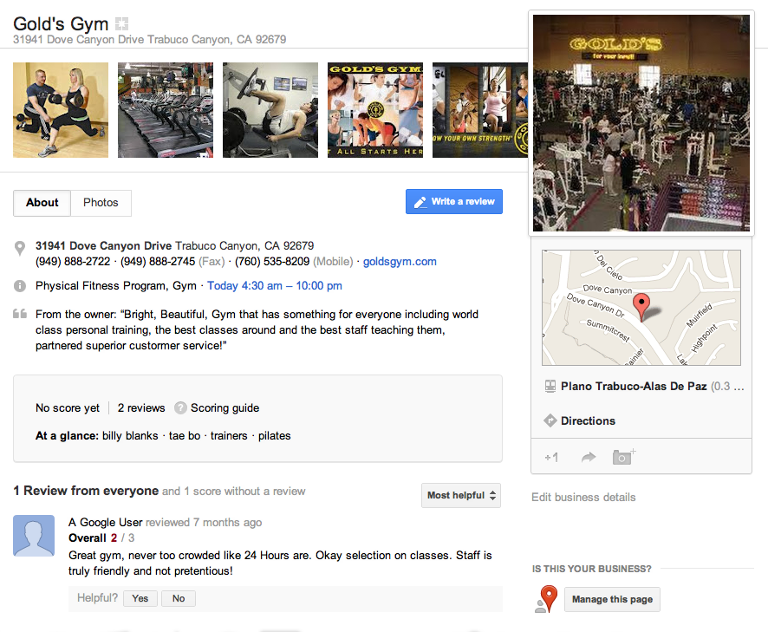
Optimized Google+ Local Page
Photos
Address
Categories
Description
Reviews

Slide 22









Increase Popularity - Citations
Your Business
OrangeSoda has access to over 5k directories

Slide 23
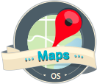
Maps Optimization Summary
What it is:
The act of enhancing a Google Map listing so it receives more exposure when someone conducts a local search.
How you do it:
Increase Map listing relevance (content) and popularity (web citations)
Why it’s important:
In 2011, Google had 3 billion searches a day
17% of searches are done with the intent to find a company that provides a specific product or service
90% of searchers only look at the first page
80% of clicks go to the organic listings
Maps Optimization should be considered the most important method involved within a local online marketing campaign.

Slide 24
Pay-Per-Click (PPC)

Slide 25

PPC
PPC: PPC stands for pay per click. This is the act of renting search engine ad space on a per click basis. It is the quickest way to drive traffic to a website.
How it Works: Since organic placement takes time, search engines allow businesses to rent ad space on their front page. Businesses bid for placement and compete for their targeted keywords. Having a quality structured PPC campaign allows you to maximize your exposure for less.

Slide 26
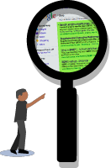
Keyword Research
Targeted Keywords
find computer repair | trojan virus
computer repair | email virus
local computer repair | blue screen editor
best computer repair | local computer virus
affordable computer repair | spyware removal
computer repair in | malware viruses
cheap computer repair | virus scan virus
repair my computer | virus removal in
broken computer | trojan virus removal
virus removal | local virus removal

Slide 27
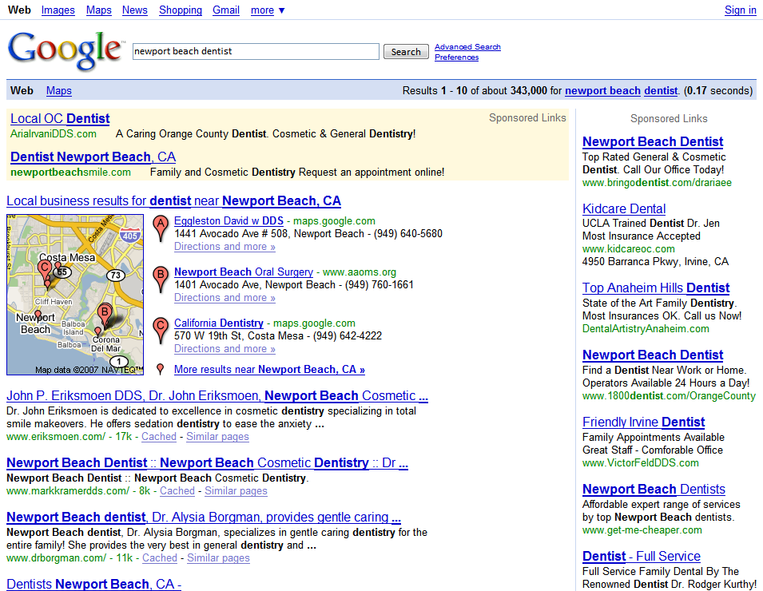

PPC Ad Copy

Slide 28

Refining a PPC Campaign
We do all the work so that client can spend time running their business:
Improve quality score
Bid aggressively
Change keyword match type
Day part
Add negative keywords
Test different ad variations
Test landing pages

Slide 29
PPC is Like…
FOR RENT
…renting a store front in a shopping mall where only people interested in your service frequent. The best part is, you only pay rent on your property when somebody walks into your store.

Slide 30

PPC Summary
What it is:
Renting search engine ad space to drive relevant traffic to a website
How you do it:
Building out a quality structured campaign with ongoing conversion optimization
Why it’s important:
20% to 30% of all traffic goes through the sponsored ads
Allows the client to focus on dozens to hundreds of terms
Highly focused
Highly trackable
PPC is the best way for clients to get immediate traffic

Slide 31
AM’s
Reporting

Slide 32
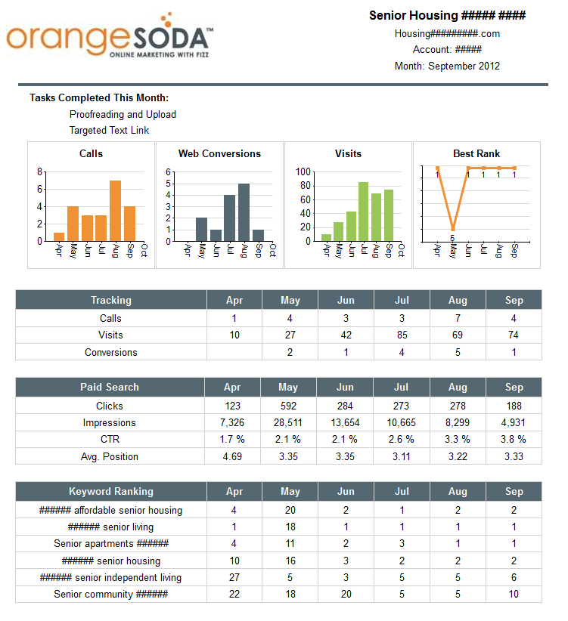
Push Reports
On a monthly basis, the client will receive a roll-up report that shows their progress in Maps, SEO, website traffic, and leads. Report is currently delivered by email.

Slide 33
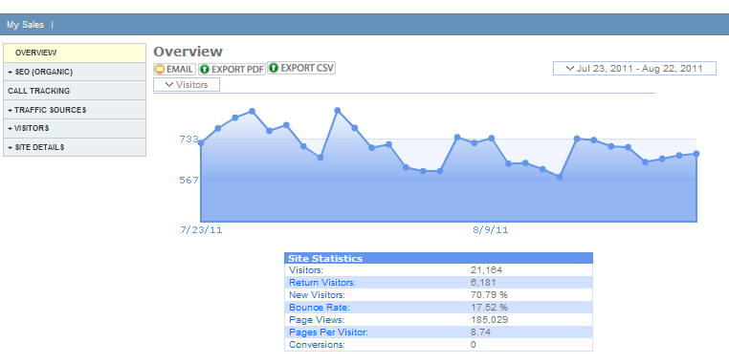
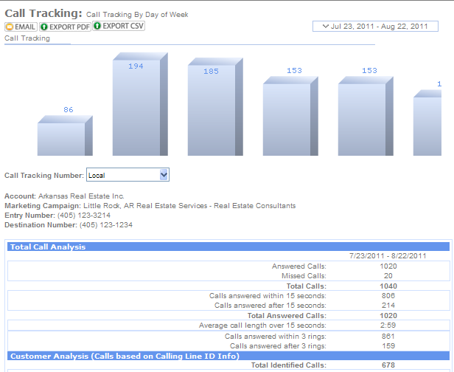
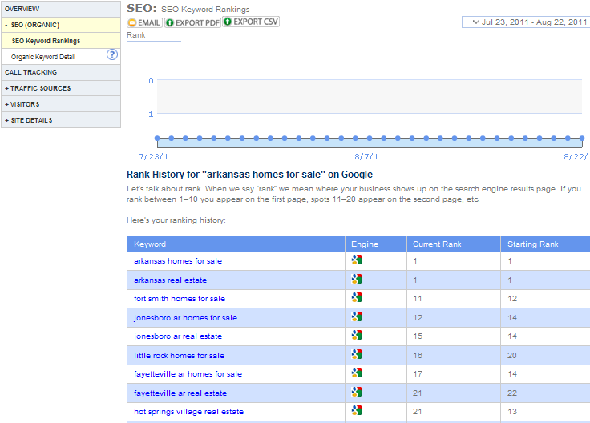
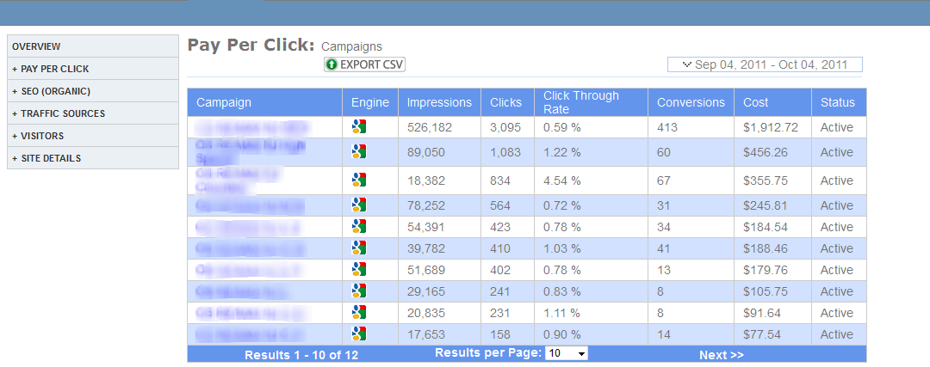
Dashboard Reporting
Our reporting
dashboard allows
clients to
monitor the
success of their
campaigns.

Slide 34

Dedicated Customer Service
Our Campaign Management Team
Strategy and Implementation
Proactive Campaign Management
Subject-Matter Expertise
Deep experience in SEO, PPC, and Optimization
In-depth knowledge of industries and brands
Tactical Management
  Campaign roll-out
  Custom reporting
  Analysis and Advisement
Ongoing data analysis and reporting
Continuous campaign optimization

